Slide 1
Nitrogen Runoff

Slide 2
Land use change over time

Slide 3
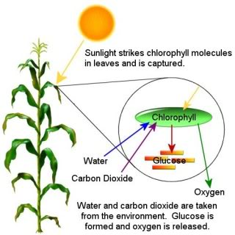
Importance to Plants
Macronutrient – plants need large amounts of it to sustain basic metabolic functions
Plants have 1-6% of nitrogen by weight
Building block for structure and function
Essential to produce amino acids which then produce proteins
Functional group on enzymes allowing them to complete specific reactions
Building block of nucleic acids that make up DNA and RNA
Nitrogen is in the center of the chlorophyll molecule which allows plants to photosynthesize
Nitrogen uses carbohydrates giving the plant structure
Nitrogen builds the protein found in grain (wheat, corn, etc.) that humans then eat
Grain is graded on protein
Low protein might return a low price for the grain to the farmer

Slide 4
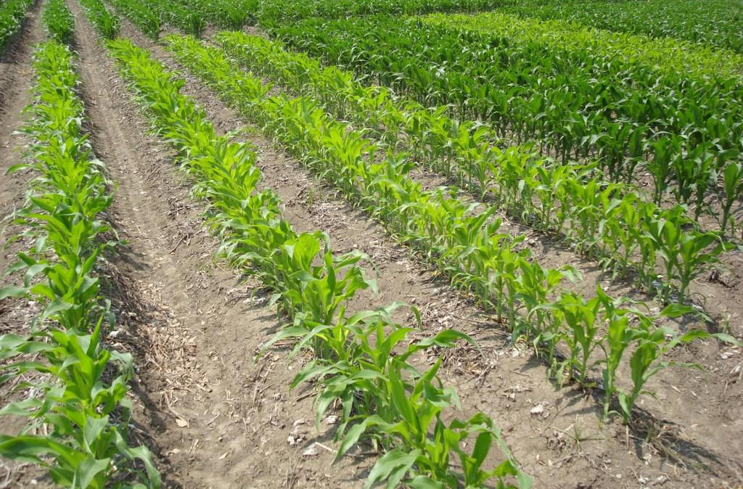
Nitrogen Deficiencies
If nitrogen resources in the soil are limited, crop growth and production becomes impaired
If nitrogen in soil is low, soil amendments (fertilizers) are added to increase nitrogen levels.
Plants deficient in nitrogen will show signs of yellowing
Plants deficient in nitrogen will not be able to complete metabolic functions
Decreased growth and vigor
Crop yield and quality decreases
Rich, green color, sufficient nitrogen
Yellow coloring, nitrogen deficient

Slide 5
Natural Nitrate Levels
https://youtu.be/cJffz_CRISI

Slide 6
Natural Nitrate Levels
Soil levels will be different in every field
We can measure nitrate levels in food (per 100 gram serving)
Arugula: 480 milligrams
Rhubarb: 247 milligrams
Butter leaf lettuce: 200 milligrams
Beets: 110 milligrams
Carrots: 92-195 milligrams
Spinach: 24-387 milligrams
Cauliflower: 20-50 milligrams
Most of the nitrates in our diet come from vegetables

Slide 7
Natural Nitrate Levels – Health benefits
Treat hypertension
Treat high blood pressure
Lower risk of heart disease
Act as antimicrobials in the digestive system

Slide 8
Natural Nitrate Levels – Problem
Infants (under 6 months of age) exposed to large amounts of nitrates usually in drinking water cannot process the nitrates.
This can lead to a dangerous condition called methemoglobinemia sometimes called blue baby syndrome
Hemoglobin in the blood cannot carry oxygen to cells
Bluish color in the skin results
Severe cases can result in death
This can result when nitrates are more than 10 parts per million in water
278 cases in 1940s and 1950s. Only two cases have been reported since the 1960s.
Today, municipal water is treated to have no more than 10 parts per million of nitrates

Slide 9
Nitrogen in Agriculture
Increase production of cereal crops (corn, wheat, rice, etc.) highly correlates with increased use of nitrogen fertilizers
This was known as the Green Revolution
Nitrogen not used by plants stays in the soil, is converted to gas through denitrification, or leaches into waterways
Sources of added nitrogen include:
Organic sources: legumes, poultry or cow manure (only 50-70% is plant available)
Inorganic sources: ammonia or urea (98% is plant available)

Slide 10
Causes of nitrogen runoff
Nitrate is soluble in water
Nitrate is negatively charged and doesn’t have an ion bond with soil particles
If water supply is too high, nitrate stays in solution and can leach out of soil or drain out through tile lines
Leaching can increase
from high rates of nitrogen fertilizers applied
fertilizing during rainy seasons
low nitrogen uptake by the crop
coarse soil textures.

Slide 11
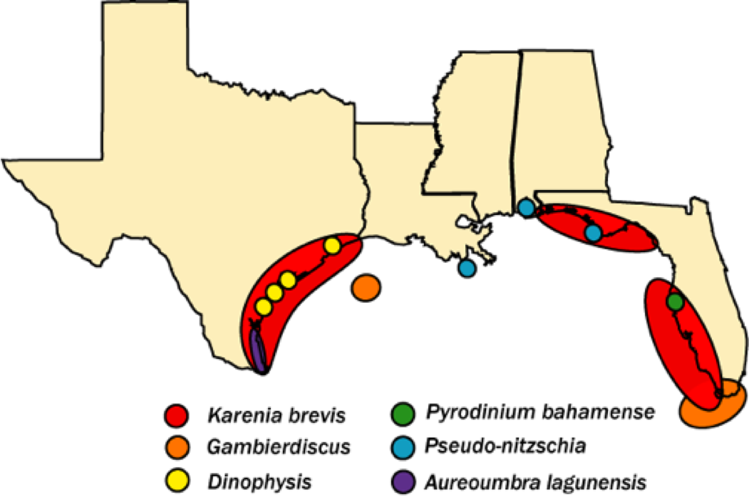
Problems of excess nitrogen runoff
Contamination of drinking water: human health concerns (blue baby syndrome)
Applied ammonium can reduce soil pH and lower soil quality
Algae bloom – dead zones depleting dissolved oxygen in bodies of water like the Gulf of Mexico (below)

Slide 12
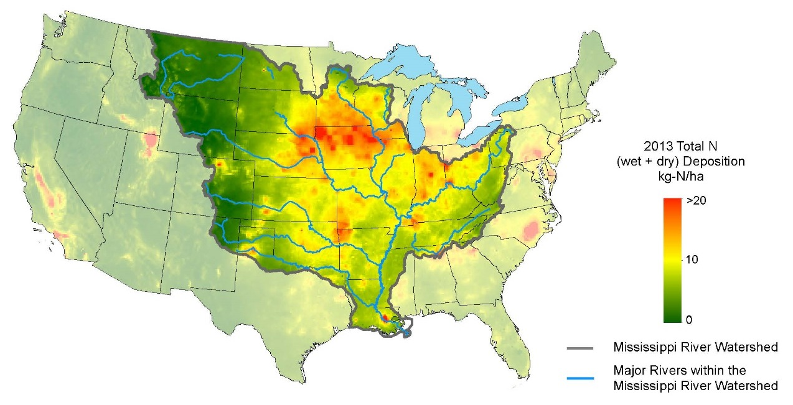
Nitrogen deposits into the Mississippi Watershed
Source: http://nadp.sws.uiuc.edu/newsletter/nl3/

Slide 14
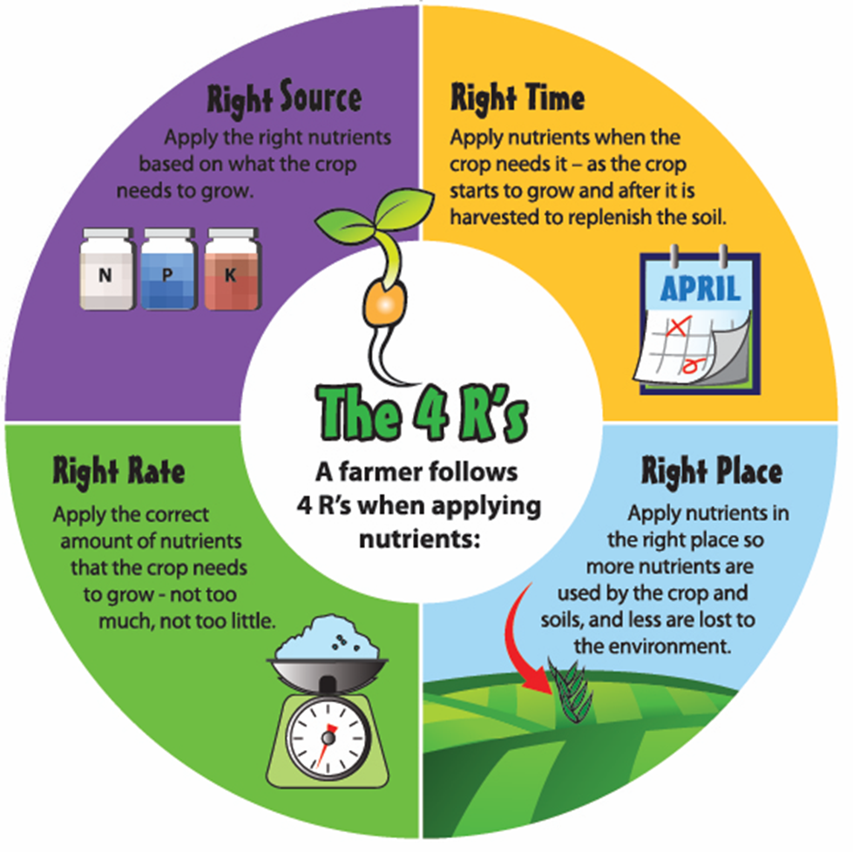
Nutrient Management – to minimize nitrate runoff
Notes:
Nutrient management
Right Source: Apply the right nutrients based on what the crop needs to grow
Manure and other organic matter
Inorganic nitrogen like anhydrous
Right Time: Apply nutrients when the crop needs it – as the crop starts to grow and after it is harvested to replenish the soil
Apply when temperature is below 50 degrees F to minimize leaching
Apply right before peak crop maturation when plant is readily using nitrogen
Right Place: Apply nutrients in the right place so more nutrients are used by the crop and less are lost to leaching
Variable rate technology adjusting the rate of fertilizer application based on soil tests and soil maps of the field
Manure injection to minimize smell and deliver nutrients to root zone
Right Rate: Apply the correct amount of nutrients that the crop needs to grow – not too much, not too little.
Variable rate technology adjusting the rate of fertilizer application based on soil tests and soil maps of the field

Slide 15
Land Management – to minimize nitrate runoff
No-till farming
Cover crops
Terracing
Tiling
Bioreactors
Buffer zones
Riparian area management

